Slide 1
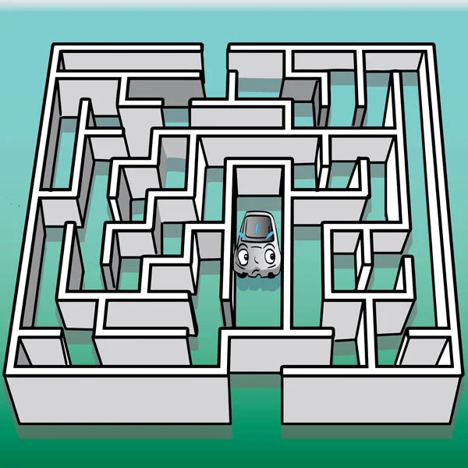
Generating Visualizing and Navigating a maze in Webots
Under the guidance of
Primary Supervisor
Terry Payne
Secondary Supervisor
Valentina Tamma
Final Presentation By: Rishabh Jaiswal201540604

Slide 2
Project Description
How does autonomous cars navigate in an unknown area? Or how does robot vacuum cleaner move around the room?
Real world unknown location can be mapped as a maze with obstacles, walls and allowable moving area in the form of Worlds in webots
Webots – Robot simulation software that allows user to create 3D virtual worlds with physical properties and programmable robots to exhibit desired behavior.
World - A world, in Webots, is a 3D description of the properties of robots and of their environment
Robot – Adept pioneer 2 is a three-wheeled robot (2 motorized wheels and one passive caster wheel) mounted with several sensors including 16 ultrasonic sensors
To find the shortest path to a location we need to read this world file and convert it to a programmable form.
After successfully reading this file all the location of walls and obstacles along with their volumes can be abstracted and mapped to a 2D binary array where enclosed area by 1s denotes the area enclosed by obstacles and 0 denotes the free area
Now we have the allowable paths for the robot but to solve the problem of finding the shortest path this areas are converted into a graph
Now on this graph shortest path finding algorithm A* is applied and the shortest path is calculated
A Wall following robot is not simulated to navigate on this path

Slide 3


Aims and Objectives
Aims
Create a maze and generate both a volumetric and a feature map by parsing a configuration file. The user should then be able to specify a destination location and a two-wheeled differential drive robot should then navigate from its current position to the destination using a planning algorithm.
Objectives
Build a test maze and two evaluation mazes of increasing complexity
Create a volumetric (grid-based binary) map to aid in maze visualisation
Create a feature (graph-based) map with nodes at intersections
Implement a route planning algorithm (A*) that uses the feature map to discover a route to a certain location.
Create a user-friendly interface for Webots so that users may choose a destination and provide telemetry.
a differential drive robot should use a wall following (or other) algorithm to navigate the map.

Slide 4
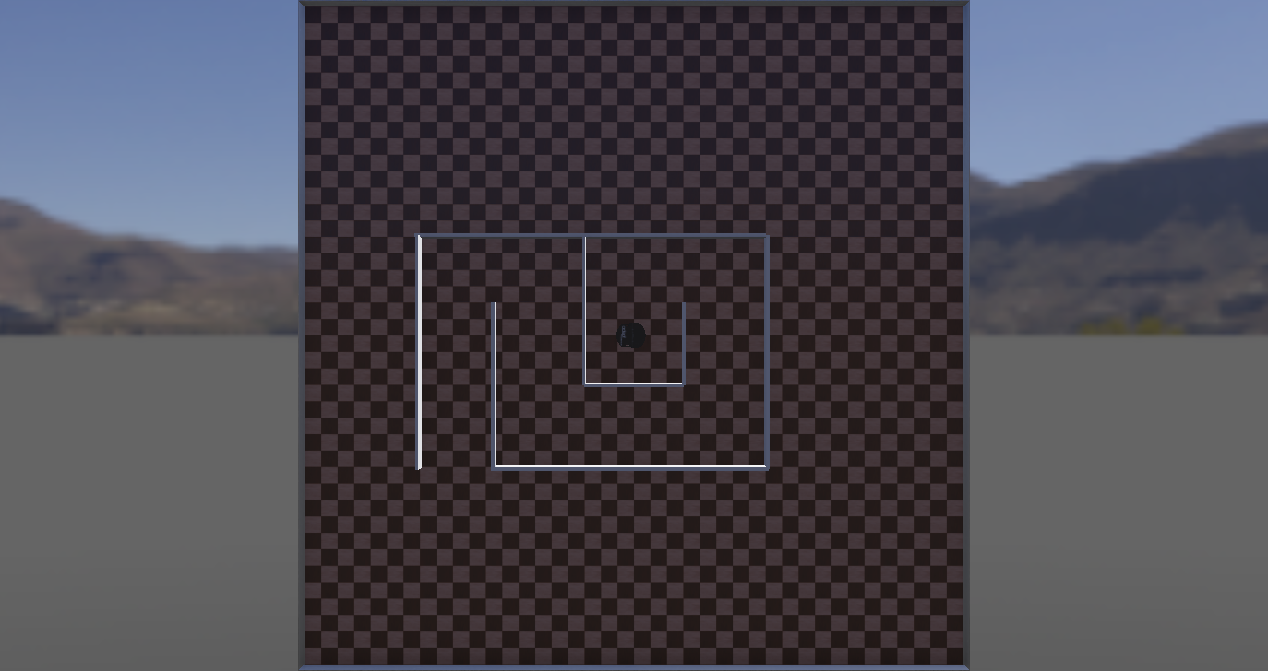
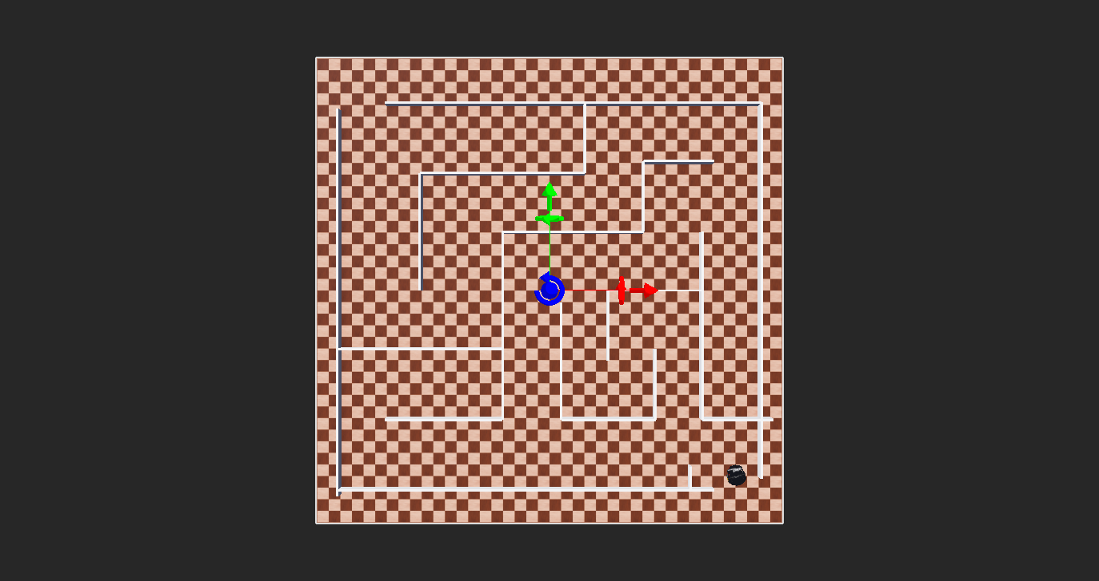
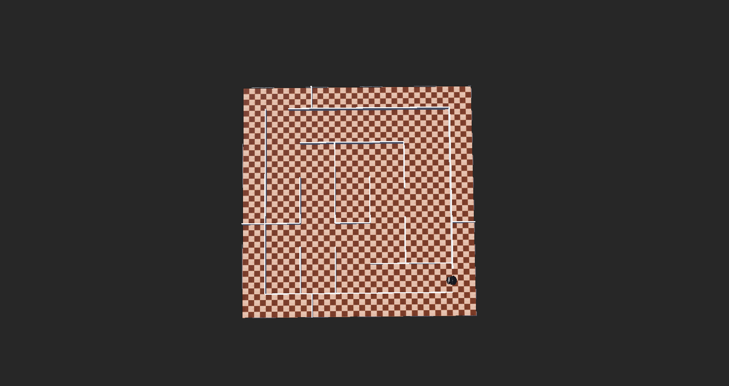
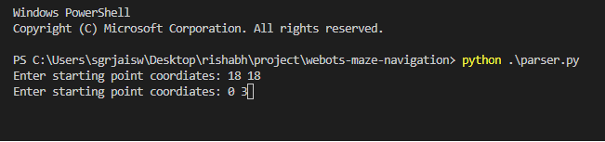
Output
A python program was developed in which the user can input the entry and destination location from the users and gives the shortest path using the terminal.

Slide 5
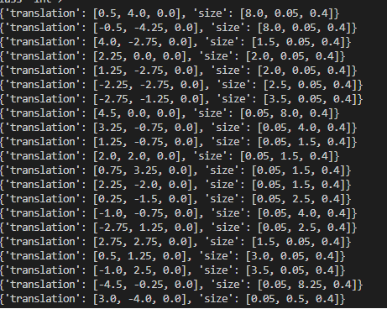
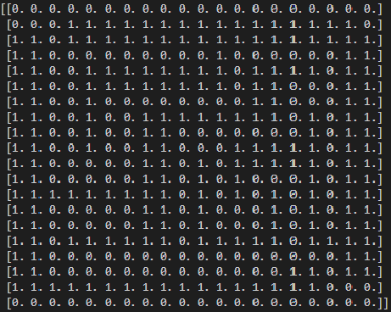
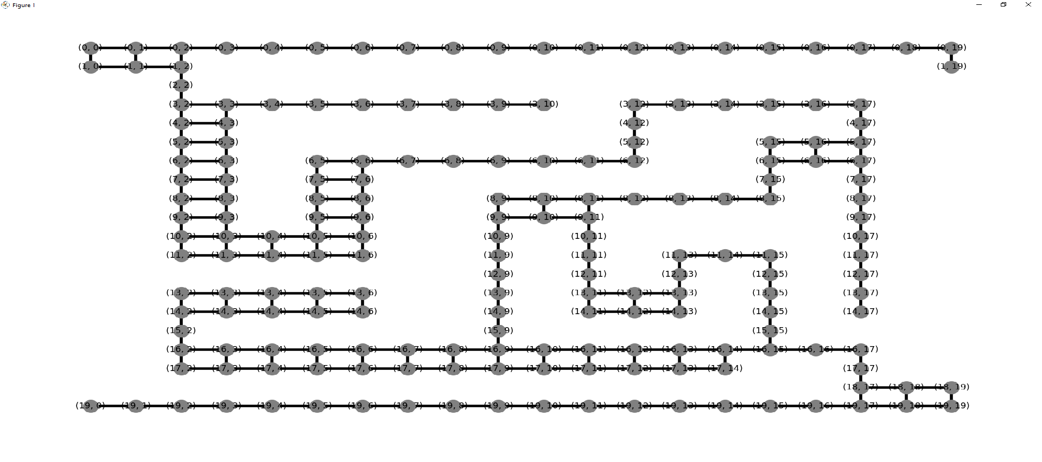
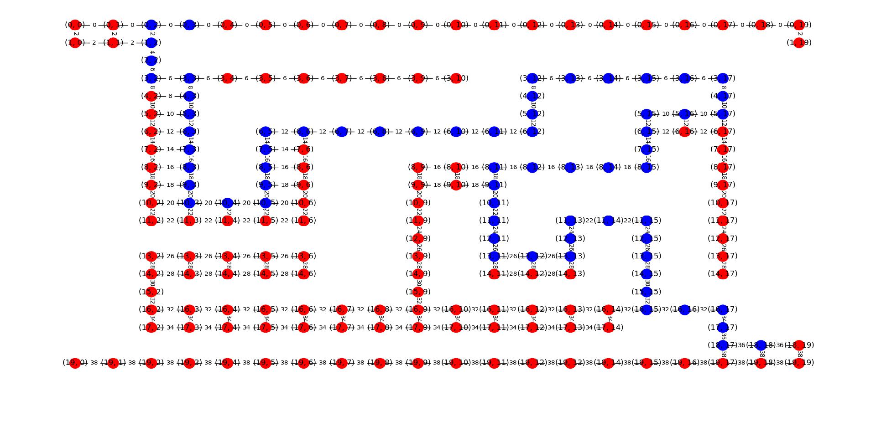

Slide 6
Evaluation
Two evaluation mazes was developed with increasing complexity in the number of intersection of walls called nodes
Both the mazes contains two paths between starting and ending locations
The software presents the shortest path which was further verified by calculating the distances of all the path
Changes made from original proposal includes:
The proposal was to use both configuration file and sensors to make grid map but sensor based approach was not implemented as it was a much harder problem
The proposal was to convert grid map to graph map using Voronoi diagrams. But it was implemented using networkx library of python for faster development of the software

Slide 7
Software Demonstration
A python program that takes starting and end point from users was developed
A test maze for development and two mazes with increasing complexity for evaluation purposes was developed(contains multiple routes)
The maze is converted into a grid based Volumetric binary map in the form of 2D array
This volumetric map is converted to feature based graph map
A* route planning algorithm was implemented to produce the shortest in the grid

Slide 8
THANK YOU!!!

